Slide 1
SCIENTIFIC CALCULATOR
A MINI PROJECT
UNDER THE GUIDANCE -- MS. ANKITA WADHAWAN
SUBMITTED BY : -- MIHIR KUMAR SHRESTHA
REG. NO. : -- 12223347
SECTION : -- KOC47

Slide 2
TECHNOLOGIES USED
PYTHON –
Python is an interpreted, object-oriented, high-level
programming language with dynamic semantics developed
by Guido van Rossum. It was originally released in 1991.
This project uses:
import function
Print function
while loop
if elif statement

Slide 3
ABOUT PROJECT
TITLE : -- SCIENTIFIC CALCULATOR
OBJECTIVE : -- To build a scientific calculator that performs several functionalities respectively
DESCRIPTION : --
This Calculator is able to perform --
Add, sub, multiply, divide, and mod (%) operations on entered integer or floating type numbers.
Square root, exponent
Sine, cosine, and tangent (Trigonometric functions).
Conversion from radian to degree and degree to radian.

Slide 4
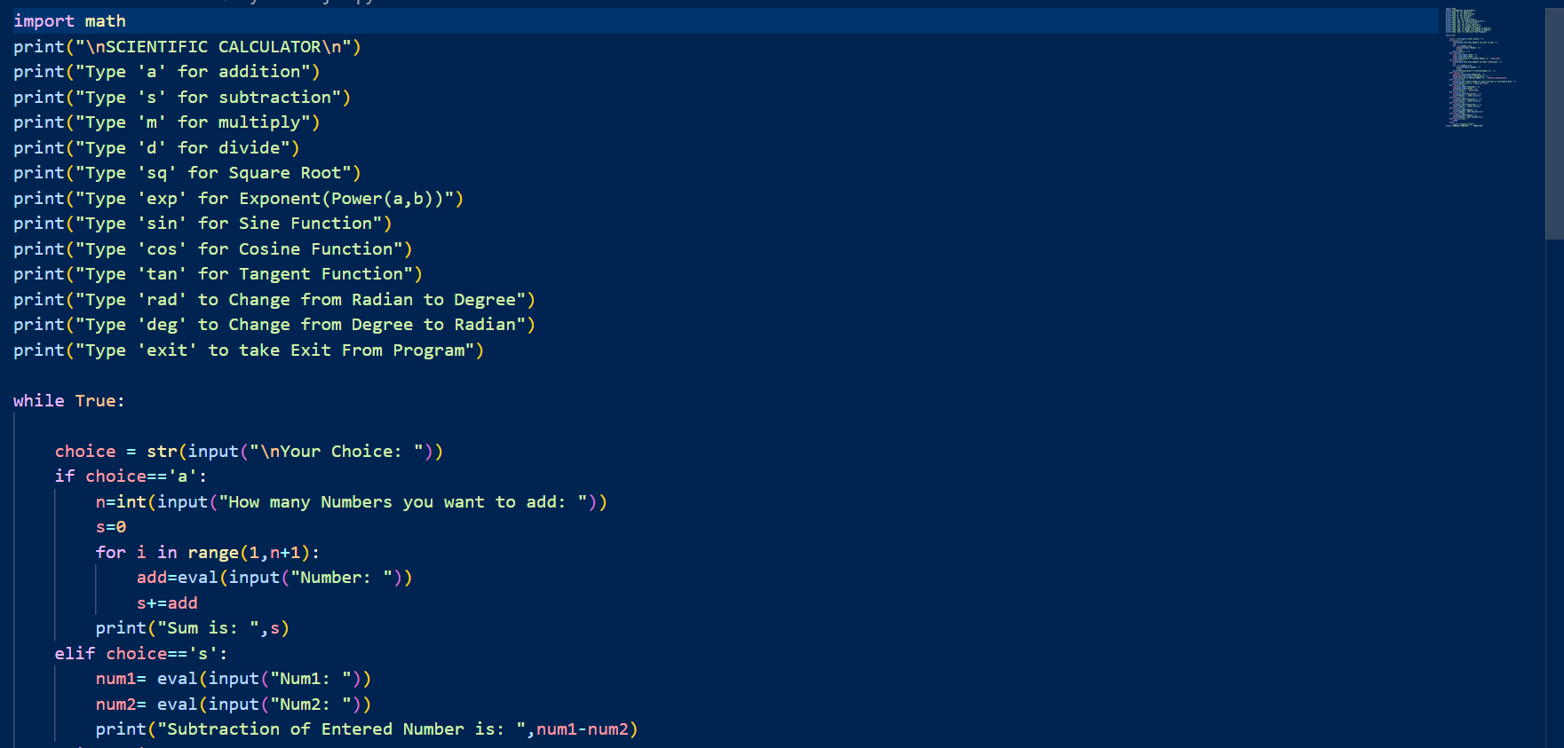

Slide 5
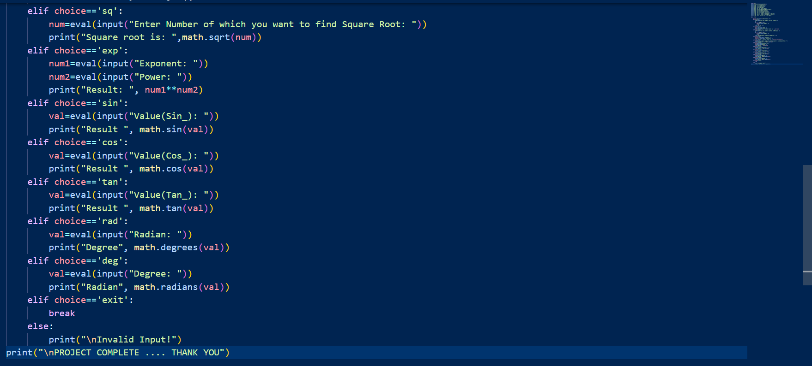

Slide 6
THANKING YOU……

